Slide 1

Department of CSIT
COURSE NAME
FOUNDATIONS OF CLOUD-NATIVE COMPUTING & DEVOPS
COURSE CODE –24CS2260F
Topic:
CI/CD Pipelines with GitHub Actions
Session -

Slide 2
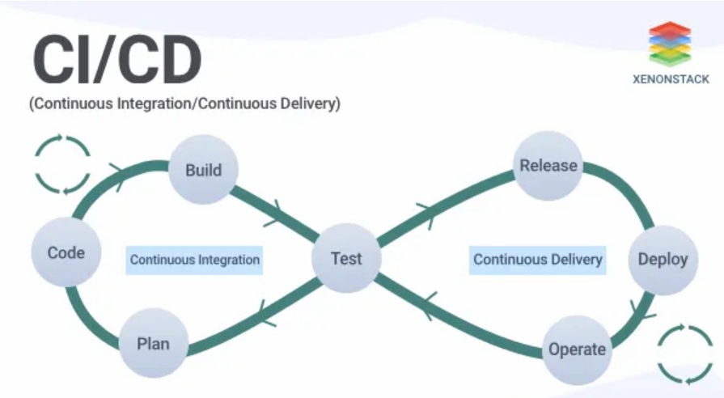
Continuous Integration (CI):
CI is when developers merge code into a shared repository multiple times a day, with automated tests and builds running to verify the code.
Continuous Deployment (CD):
CD automates deployment to production once tests pass, while Continuous Delivery prepares the code for deployment, needing manual approval.

Slide 3
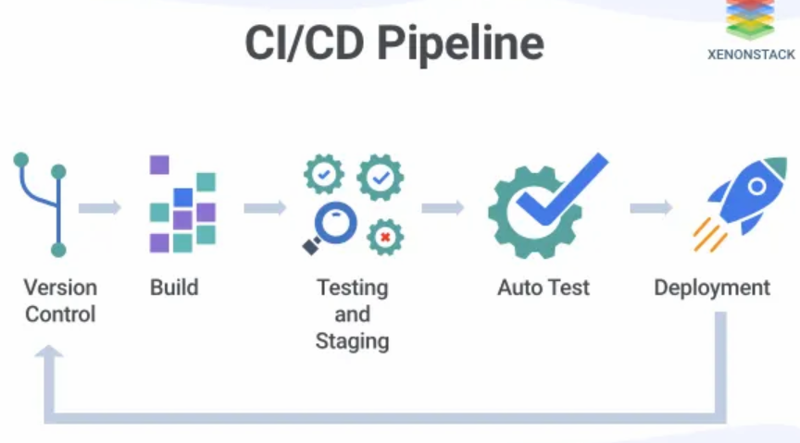

Slide 4
CI/CD Pipeline Flow in the Image:
Version Control: Developers commit code changes to a Git-based version control system (e.g., GitHub, GitLab).
This is the first step where developers work with branches (feature branches, main branches, etc.) and push code changes.
Build: After the code is pushed, it triggers the build process.
The system compiles or packages the code into a runnable form, such as a .jar file, Docker image, or executable application.
This step also ensures that all dependencies are correctly handled (for example, using npm install for Node.js or pip install for Python)

Slide 5
.
3.Testing and Staging: The next step automatically tests the code in a testing environment (usually an isolated server or a staging environment that mimics production).
Various tests, like unit tests, integration tests, or smoke tests, are run here.
If tests fail, the pipeline will stop, and the developers will be notified to fix the issues before the code can move forward.
4.Auto Test: This emphasizes the automated nature of testing in the pipeline.
As part of the testing process, auto tests are run to ensure that no issues are introduced with the new changes. This is done automatically and is a critical part of ensuring code quality.
5.Deployment: Once tests are successfully passed, the application is deployed to the production environment.
This can be done using Continuous Deployment or Continuous Delivery, depending on the organization’s configuration.

Slide 6
CI/CD pipelines can be implemented using:
GitHub Actions: A built-in automation tool within GitHub that can be used to define CI/CD workflows directly in your repository.
Jenkins: A widely used open-source automation server that supports building, testing, and deploying applications as part of the CI/CD pipeline.
Both tools allow you to automate various stages of the development lifecycle, from code integration to testing and deployment.

Slide 7
GitHub Actions

Slide 8
GitHub Actions are one of the most helpful features of GitHub. Actions help you automate, build, test, and deploy your app from your GitHub. They also help you perform code reviews and tests, manage branches, triage issues, and more.
Key GitHub Actions Concepts
Workflows
Events
Jobs
Runners

Slide 9
1. Workflows
A workflow is a configurable automated process that runs one or more jobs. It is created with a YAML file in your repository and runs when an event triggers it.
Workflows are defined in the .github/workflows directory in a repository. In the repository, you can create multiple workflows that perform different tasks, such as:
Building and testing pull requests
Deploying your application on the cloud
Running a test on every pull request

Slide 10
2.Events
An event is a specific activity in a repository that triggers or runs a workflow in your GitHub repository. For example, when you push code to the repository, it triggers the push event.
These are some common GitHub Action events:
Push
pull_request
release
label
issues
milestone
label

Slide 11
3.Jobs
GitHub Action jobs run in parallel by default. A GitHub Action workflow runs one or more jobs, each containing a set of steps that execute commands or actions.
4.Runners
Runners are servers that execute workflows when triggered. Each runner can handle only one job at a time. GitHub offers runners for Ubuntu Linux, Microsoft Windows, and MacOS to run your workflows.

Slide 12
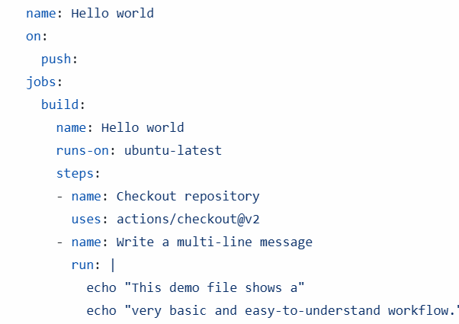
Apply a GitHub Actions workflow that is triggered
by a push event
to the repository:

Slide 13
Explanation:
name: Hello world — This is the name of your workflow.
on: push — This specifies that the workflow will run when a push event happens (i.e., when code is pushed to the repository).
jobs: — You've defined one job called build
runs-on: ubuntu-latest — This defines the environment the job will run on.
Steps:
Checkout repository — This step uses the actions/checkout@v2 to clone your repository. This is necessary if your workflow needs to interact with the code.
Write a multi-line message — This runs the echo commands to output a multi-line message to the log. The | allows you to include multiple lines in the run command, which will be printed in the log.

Slide 14
How to do step by step procedure

Slide 15
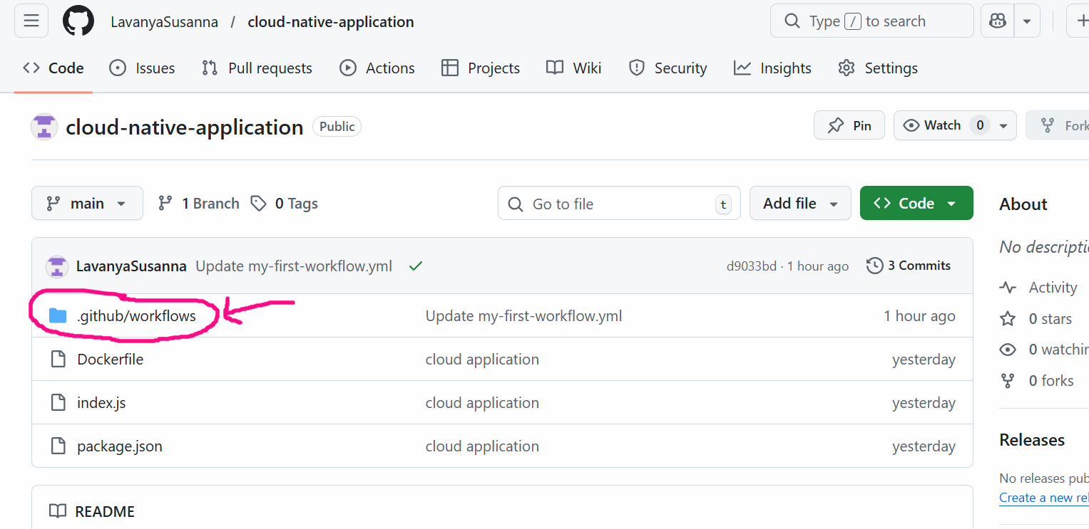
1.Create a repository named .github/workflows in the given repository

Slide 16
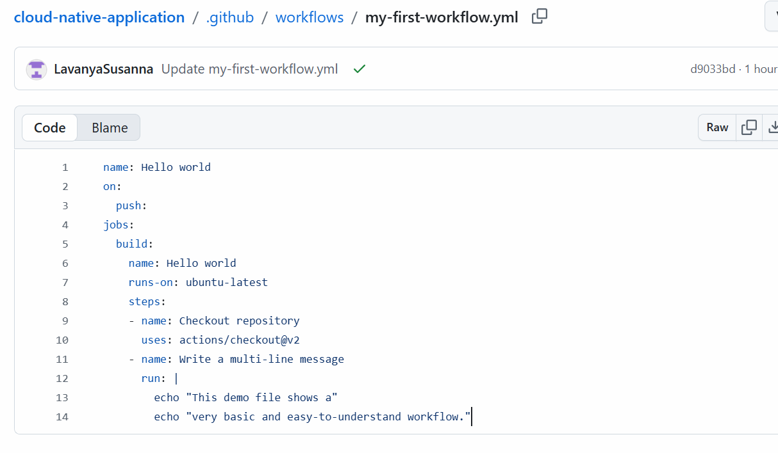
2. Create the yaml file and then click on commit changes

Slide 17
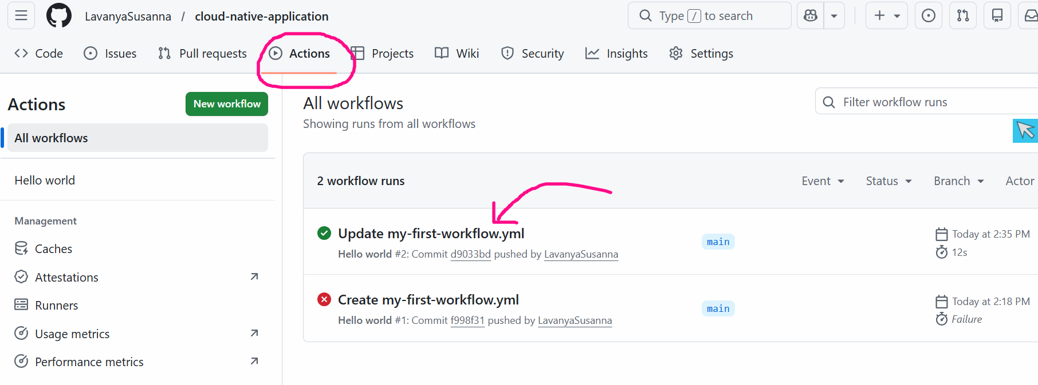
3. Go to the repository’s page on GitHub and click the Actions tab under the repository’s name

Slide 18
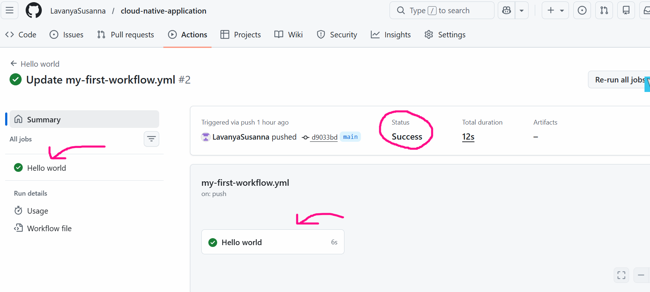
4.The job name and status will appear on the left. In this case, it will be Hello World

Slide 19
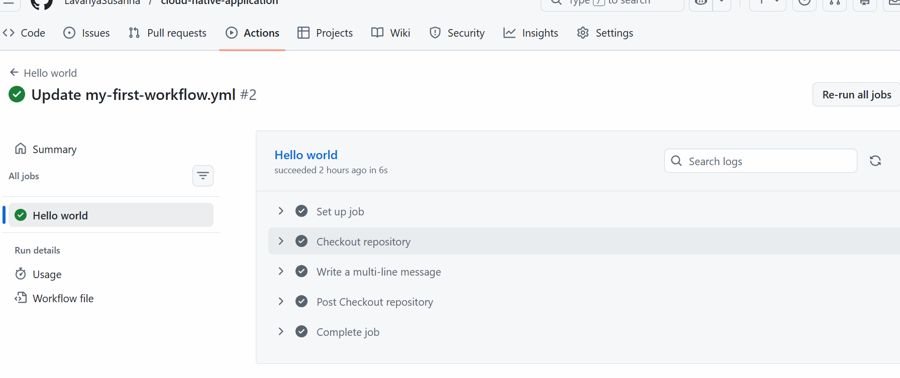
5.Clicking on the job will show the output from each step in the workflow.

Slide 20

THANK YOU
Team –Foundations Of Cloud-native Computing & Devops

